Slide 1
Emerging and Re-emerging Arbovirus Infection National and Regional aspect
Prof. Quazi Tarikul Islam
Professor and Head of Medicine
Popular Medical College, Dhaka
BANGLADESH
prof.tarik@gmail.com

Slide 2
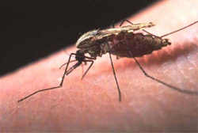
Arthropod borne viral Diseases
Arboviral disease is a general term used to describe infections caused by a group of viruses spread to people by the bite of infected arthropods (insects) such as mosquitoes and ticks
These infections usually occur during warm weather months, when mosquitoes and ticks are active

Slide 3
Arthopod borne viral Diseases
Arthropods form a major group of pathogen vectors with mosquitoes, flies, sand flies, lice, fleas, ticks, and mites transmitting a huge number of pathogens
Many such vectors are haematophagous, which feed on blood at some or all stages of their lives

Slide 4
Flaviviridae
A family of positive, single-stranded, enveloped RNA viruses
Found in arthropods, (primarily ticks and mosquitoes), and can occasionally infect humans

Slide 5
Classification
Flaviviridae
Group IV ((+)ssRNA)
Family: Flaviviridae
Genera:
Hepacivirus- HCV
Flavivirus- Yellow fever, Dengue, Zika, West nile
Pegivirus
Pestivirus

Slide 7
There is extensive geographic distribution
and the diversity of the arthropod vectors or
vertebrates hosts associated with biological
transmission of these viruses

Slide 9
Yellow fever, which has epidemiological similarities to dengue, was under control in the mid-20th century, but is once again increasing
Japanese encephalitis virus is numerically the most important cause of epidemic encephalitis; its geographical area is expanding despite the availability of vaccines

Slide 11
Arboviruses
Flaviviruses are transmitted by Mosquitos
Yellow Fever, Dengue Fever, Japanese encephalitis, West Nile viruses, and Zika virus
Flaviviruses are transmitted by ticks
Tick-borne Encephalitis (TBE), Kyasanur Forest Disease (KFD) and Alkhurma disease, and Omsk hemorrhagic fever

Slide 12
Arboviruses
Chikungunya fever – Alphavirus (Togaviridae)

Slide 13
Evolution
The origin of these viruses- 9400 to 14,000 years ago
World dengue strains (Old World and New )- 150 and 450 years ago
tick borne encephalitis strains diverged about 1087 years ago

Slide 14
Kunjin virus from West Nile virus -277 years ago
The Japanese encephalitis in Africa 2000–3000 years ago

Slide 15
Clinical triad of flavivirus
Many are spreading to new geographical areas and causing increased numbers of infections
Traditionally, three clinical syndromes are recognized:
fever-arthralgia-rash
viral haemorrhagic fever and
neurological disease
Though for some flaviviruses the disease pattern is changing

Slide 16
However, Chikungunya, dengue and Zika exist predominantly in a human-mosquito cycle
These viruses grow very well in the human body and therefore allow the re-infection of mosquitoes

Slide 17
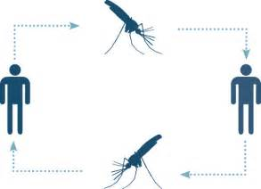
Bird-mosquito cycle
Human-mosquito cycle

Slide 18
BANGLADESH Dengue Zika Chikungunya

Slide 19
DENGUE

Slide 21
Dengue and dengue haemorrhagic fevers: global
Dengue and DHF is endemic in more than 128 countries in the WHO regions of
Africa
Americas
Eastern Mediterranean
South-East Asia and
Western Pacific
The South-East Asia and Western Pacific regions are the most seriously affected

Slide 22
Dengue and dengue haemorrhagic fevers: global
Some 3.9 billion people – half of the world's population in tropical and subtropical countries are at risk
An estimated 50 million dengue infections occur worldwide annually
An estimated 500 000 people with DHF require hospitalization each year and about 2.5% of those affected die

Slide 23
Dengue and dengue hemorrhagic fever: Key facts
Epidemics of dengue are increasing in frequency. Aedes (Stegomyia) aegypti is the primary epidemic vector
It is primarily an urban disease, but dengue and DHF are now spreading to rural areas worldwide

Slide 24
Climate change and its impact on dengue disease burden
Global warming - A 2.0 °C–4.5 °C rise in average global temperatures by the year 2100
With a 2 °C increase in temperature the incubation period of DENV will be shortened
Mosquitoes will bite more frequently because of dehydration

Slide 25
In Bangladesh first diagnosed case of Dengue was in 1999
It re-emerged in Bangladesh in 2000 after an earlier outbreak as Dhaka Fever in 1960s
According to the CDC, DGHS, in Dhaka city the total number of cases up to September 2018 is 6640

Slide 26
Dengue Cases and Death- 2000 to September 2018

Slide 27
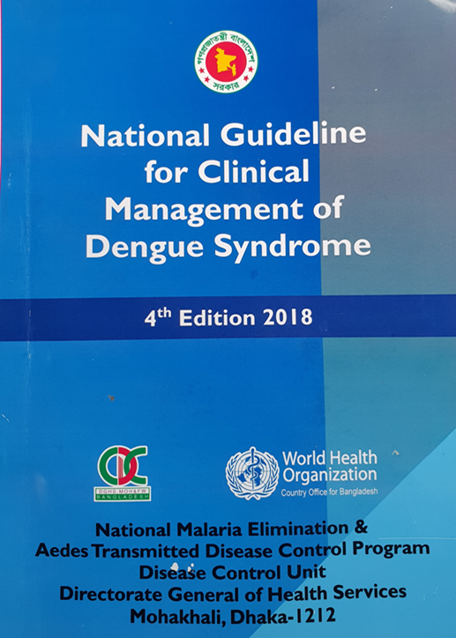
Updates on National Guidelines

Slide 28
Regional

Slide 29
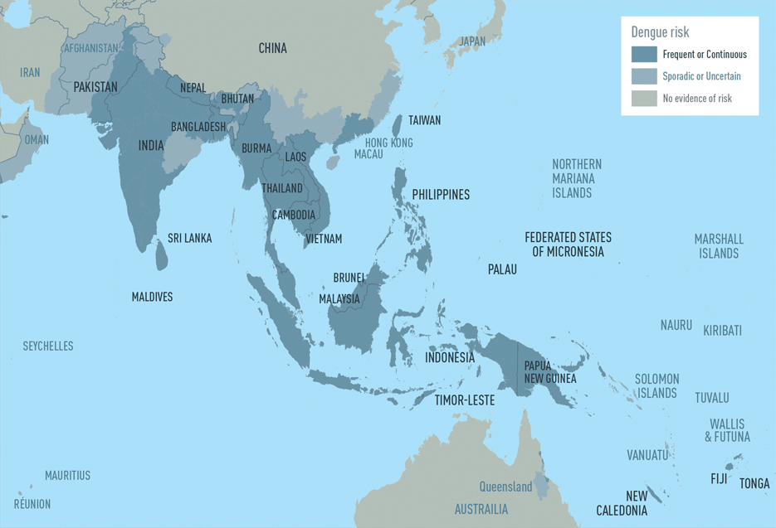

Slide 31
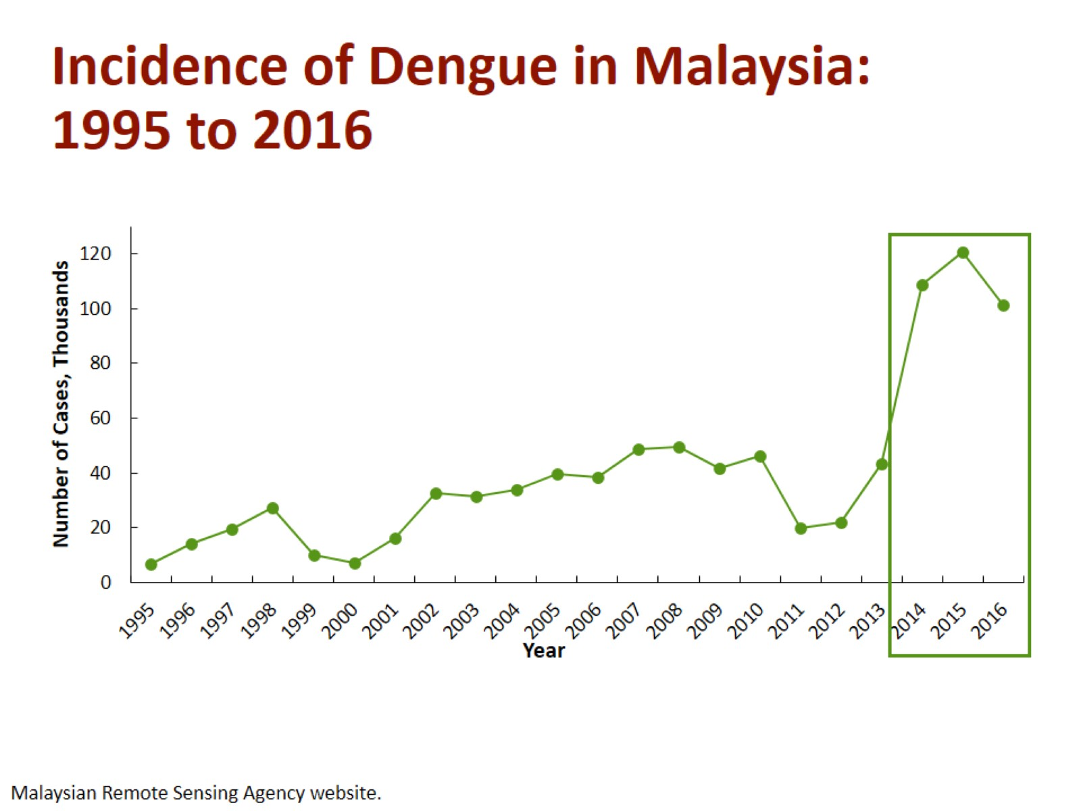

Slide 32
Struchiner CJ, Rocklöv J, Wilder-Smith A, et al. Increasing Dengue Incidence in Singapore over the Past 40 Years: Population Growth, Climate and Mobility. PLoS ONE 2015;10(8):e0136286.

Slide 33
Global

Slide 36
Dengue virus infection
10,000
Asymptomatic Symptomatic
Viral syndrome Dengue fever DHF
9,000
1,000
500
400
100
Plasma leakage
Expanded dengue syndrome (Uncommon)
Prolonged shock: liver failure,
renal failure,…Encephalopathy…
Co-morbidities
3. Co-infections
4. True dengue infection - encephalitis
DHF
DSS
1-2

Slide 37
Structure
There are four virus serotypes, which are designated as DENV-1, DENV-2, DENV-3 and DENV-4
Infection with any one serotype confers lifelong immunity to that virus serotype

Slide 38
ZIKA

Slide 39
ZIKA VIRUS
Single stranded RNA virus

Slide 40
In April 1947 Zika virus was first isolated from a rhesus monkey found in Uganda’s Zika forest

Slide 41
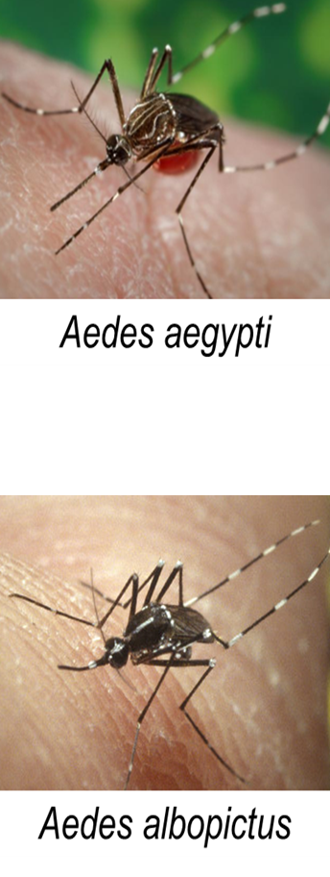
Zika virus (Zika)
Primarily transmitted through the bite of an infected Aedes species mosquito (Ae. aegypti and Ae. albopictus)
Closely related to dengue, yellow fever, Japanese encephalitis, and West Nile viruses

Slide 42
Zika-Affected Areas
Prior to 2015: Zika virus outbreaks occurred in Africa, Southeast Asia, & Pacific Islands
February 1, 2016: World Health Organization declares Zika an International Public Health Emergency

Slide 44
Zika virus clinical disease course and outcomes
Clinical illness is usually mild
Symptoms last several days to a week
Severe disease requiring hospitalization is uncommon
Fatalities are rare
Guillain-Barré syndrome (GBS) reported in patients following suspected Zika virus infection

Slide 45
Symptoms
Many infections asymptomatic
Most common symptoms
Acute onset of fever
Maculopapular rash
Joint pain
Conjunctivitis
Other symptoms include muscle pain and headache

Slide 47
Bangladesh
No Zika Virus infected case yet detected!

Slide 48
India
2017 – 3 cases in Gujrat
Zika virus: Current concerns in India
Sumit Bhardwaj, Mangesh D. Gokhale, Devendra T. Mourya, Indian J Med Res
v.146(5); 2017 Nov
2018 October – 29 cases in Jaipur, Rajasthan

Slide 49
CHIKUNGUNYA

Slide 50
Chikungunya
CHIKV Fever
Buggy Creek virus infection
Knuckle fever
Me Tri virus infection
Semliki Forest virus infection

Slide 51
First described during an outbreak in southern Tanzania in 1952
It is an RNA virus that belongs to the alphavirus genus of the family Togaviridae
Chikungunya has been identified in over 60 countries in Asia, Africa, Europe and the Americas

Slide 52
“Chikungunya” derives from a word in the Kimakonde language, meaning “to become contorted”, and describes the stooped appearance of sufferers with joint pain (arthralgia)

Slide 53
Mode of transmission
By Infected Female mosquitoes
They bite usually during day time

Slide 54
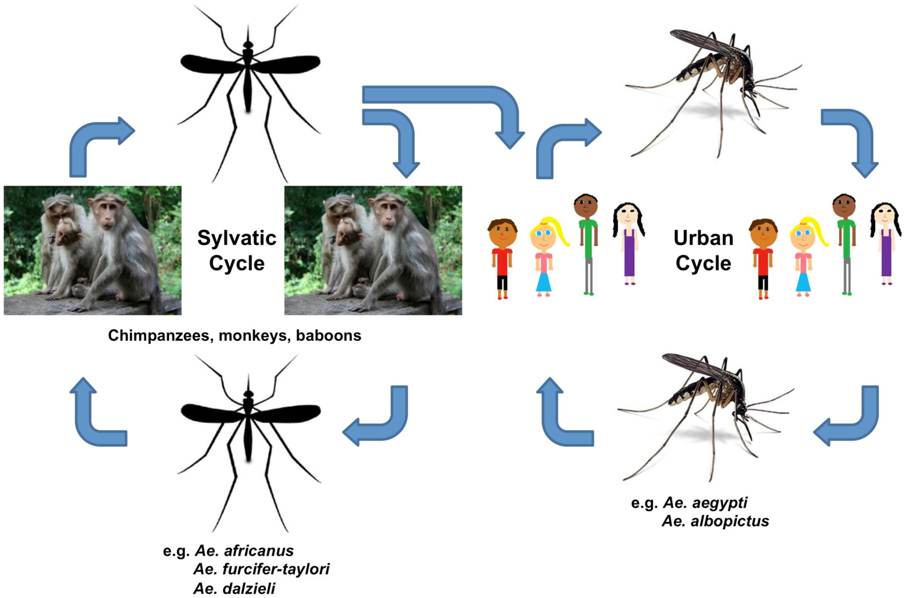

Slide 55
Sign and Symptoms (phases)
Clinical presentation of Chikungunya usually follows 3 phases:
Acute Phase (<3 weeks)
abrupt onset of signs and symptoms
Subacute phase(>3 weeks to 3 months)
generalized weakness, polyathralgia,joint stiffness
Chronic phase(>3 months)
Athritis, recurrent joint swelling after each episode of any
fever, recurrent joint pain

Slide 56
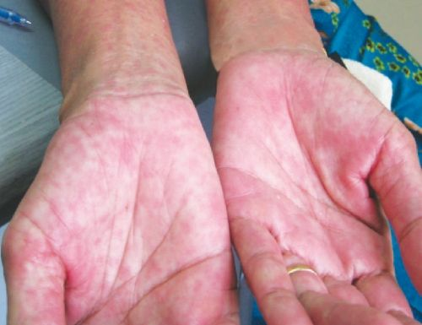
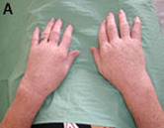
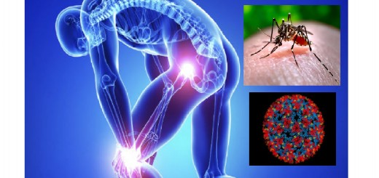
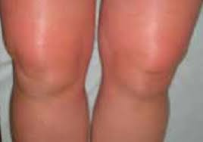

Slide 57
High Risk Group
Geriatric and pediatric age group
Any co morbid conditions (DM, HTN, CVD, COPD, Hypothyroidism etc.)
Pregnancy
Any Co-Infection(Dengue, TB, Enteric Fever, HIV, Malaria)

Slide 58
Chikungunya in Bangladesh
No evidence of chikungunya virus in Bangladesh before 2008
First identified outbreak of chikungunya in Bangladesh, 2008
2008 – Paba , Rajshahi
2009 – Shathiya, Pabna
2011 – Dohar , Dhaka
2012 - Palpara, Tangail
2013 - Chittagong ( case series)

Slide 59
Small outbreaks in different districts in Bangladesh
2008
Paba, Rajshahi
2012
Palpara
Tangail
2009
Pabna
2011
Dohar, Dhaka

Slide 60
Outbreak –Epidemic of CHIKUNGUNYA
occurred in early 2017. Causes may be
Early rain
Lack of preparedness and
Health education

Slide 61
Data of case recorded in DGHS: 13825

Slide 62
At least 1.8 million people are feared to be infected with Chikungunya in the capital this year
One in 10 people in the city are at risk of the mosquito-borne fever, says a study
July 10, 2017, The Daily Prothom Alo

Slide 63
Chikungunya outbreaks in Indian subcontinent
1983
Karachi
2014
Nepal
2008
Bangladesh
1963
Kolkata,
India
1969
Sri Lanka

Slide 64
A large outbreak of chikungunya in India occurred in 2006 and 2007
Since 2005, India, Indonesia, Maldives,
Myanmar and Thailand have reported over 1.9 million cases
Emerging Infectious diseases. www.cda.gov/eid- vol14; no10, Octber 2008

Slide 65
Territories and regions affected by Chikungunya, CDC, May 29, 2018

Slide 66
Clinical features: Zika virus compared to dengue and chikungunya

Slide 67
Take Home Massage
The factors associated with the emergence and re-emergence of arboviral diseases are complex
Collaboration among academia and public health communities is critical in efforts to contain the menace of arboviral diseases emergence/ resurgence

Slide 68
The research priorities in this field should encompass:
Understanding environmental factors which facilitate emergence, maintenance and transmission of these diseases
Studying the evolution of pathogenic infectious agents resulting in changes in infectivity, virulence, transmissibility and adaptations

Slide 69
Host factors influence in new infection and their transmission
Development of tools for diagnosis, management, control and prophylaxis
Training and infrastructure for responding to emerging diseases
Information sharing and development of research-based evidence to influence policy modifications for the public health improvement

Slide 70
THANK YOU

